Slide 1
Generating noisy speech data from clean data in the frequency domain using Deep Learning Methods
Week – 9
Name: Shashank Shirol
University: Manipal Institute of Technology
Duration of the presentation: ~10 mins.

Slide 2
Tasks to be completed:
To modify the official SinGAN implementation:
To modify the Normalization method to use 5th-percentile and 95th-percentile values for Min-Max Normalization and document results.
Try different Objective quality tests to see if they yield better results than the Log-Spectral Distance metric.
Perceptual Evaluation of Speech Quality (PESQ)
Mel-Cepstral Distance (MCD)
Try Image-to-Image translation models to see if target spectrograms could be produced by learning the mapping from clean → noisy spectrograms.
Try a Variant of CycleGAN that can learn from unpaired images -- Contrastive Unpaired Translation (CUT)[1]
[1] https://arxiv.org/pdf/2007.15651.pdf

Slide 3
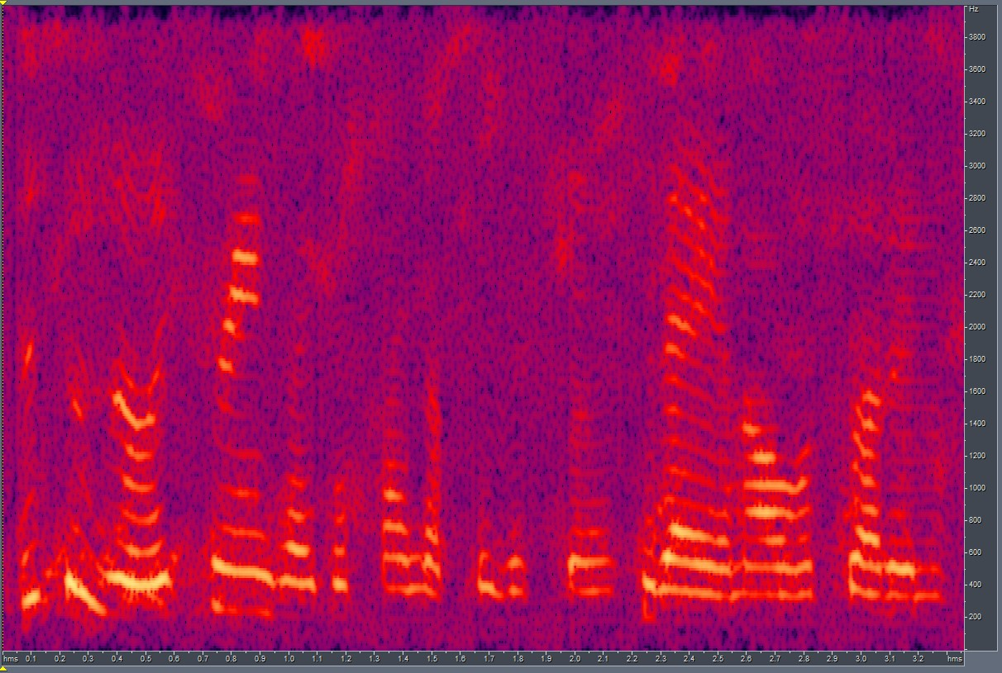
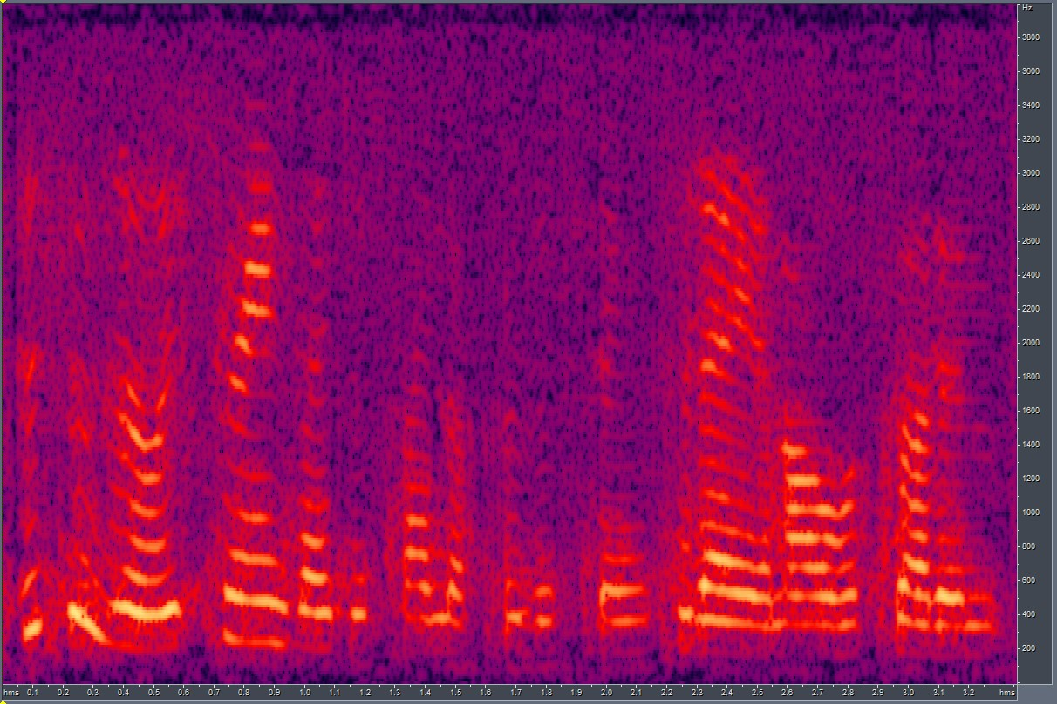
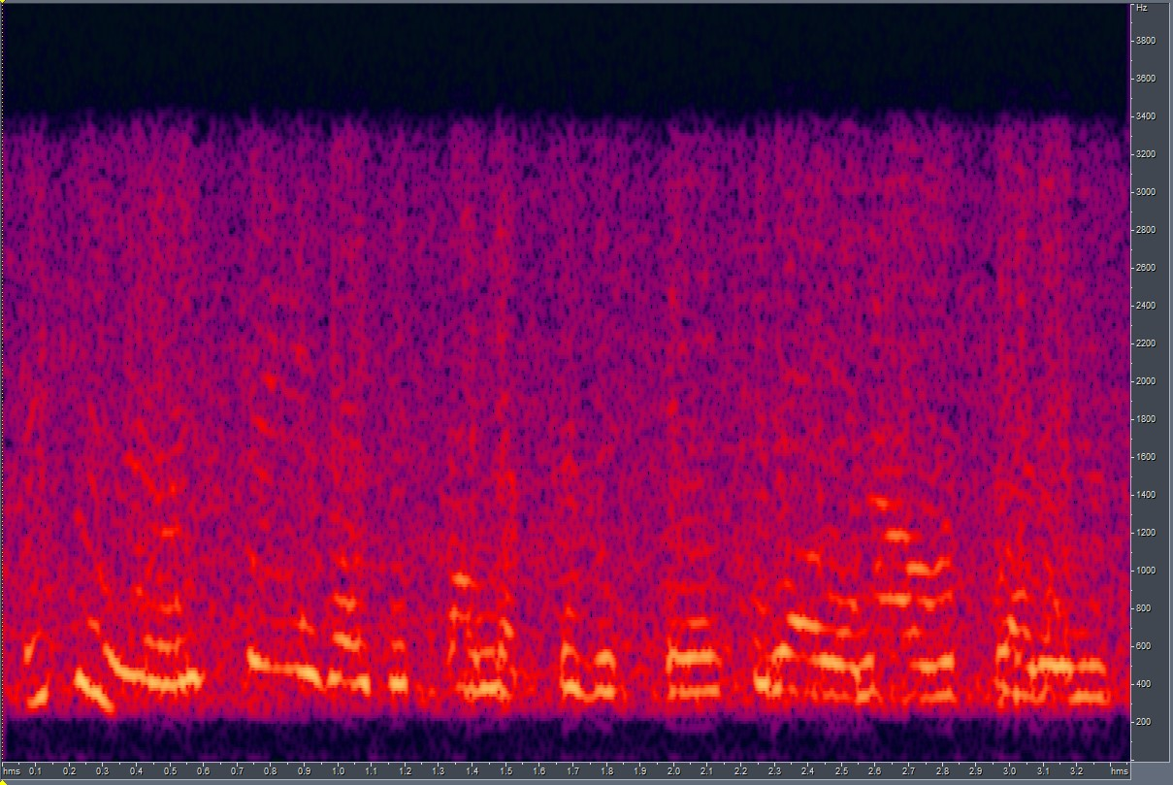
Modifying normalization code in SinGAN
Tried using 95th-percentile and 5th-percentile values for normalization and compared results with using the actual Maximum and Minimum values.
The results were as follows:
Best LSD with 95-per Normalization = 12.29
Best LSD with min-max Normalization = 11.23
Using 5-95 percentile
Using Min-Max
GT

Slide 4
Testing different Objective quality tests (I):
Perceptual Evaluation of Speech Quality (PESQ)
This is a speech intelligibility metric that takes a reference audio signal and compares it to the given audio.
The scale for scores vary depending on the implementation – P.862 gives a score in range -0.5 to 4.5 and PESQ mapping function (P.862.1) maps to the MOS-LQO range (1.02 to 4.56)
Reliability of the metric is questionable as many online forums deem this metric as outdated and suggest to use something else.
Mel-Cepstral Distortion (MCD)
This measures how different two sequences of Mel Cepstra are.
The idea being that the smaller the MCD between synthesized and natural mel cepstral sequences, the closer the synthetic speech is to the reference.
Did not find a proper python implementation – ended up implementing my own function for calculating MCD.

Slide 5

Testing different Objective quality tests (II):
The results of both the metrics were consistent with results obtained with LSD:
When LSD is low: PESQ is high, MCD is low.
When LSD is high: PESQ is low, MCD is high.
The MCD calculation depends a lot on how the MFCCs are obtained and the parameters for evaluation like n_mels, n_mfccs, n_fft etc. But so is LSD.
Need to find the optimal parameters for calculation and with good reason.
How the scores translate from LSD:
Considering LSD score between ground_truth and scale=3_output:
ground_truth
LSD = 11.23
PESQ = 1.78
MCD = 12.96
scale=3_output

Slide 6
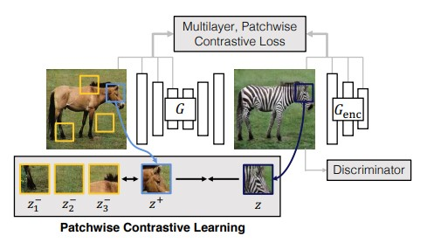
Contrastive Unpaired Translation (CUT)
CUT or Contrastive Unpaired Translation is an updated version of CycleGAN that changes the way model learns the mapping by removing the pixel reconstruction loss (cycle consistency) and the inverse network to learn inverse mapping, used originally in the CycleGAN[2] paper.
This makes CUT train almost twice as fast and it also produces comparable results than CycleGAN.
We use CUT to learn Image-to-Image translation for mapping from Clean Spectrograms to Noisy Spectrograms.
The model training specifications were as follows:
No. of Training Images:
Domain A (Clean Spectrograms): 70
Domain B (Noisy Spectrograms): 140
Paired: No
Model: CUT (other available: FastCUT, SinCUT)
Training Time: ~6.5 hours on Google Colab GPU runtime.
[2] https://arxiv.org/pdf/1703.10593.pdf

Slide 7
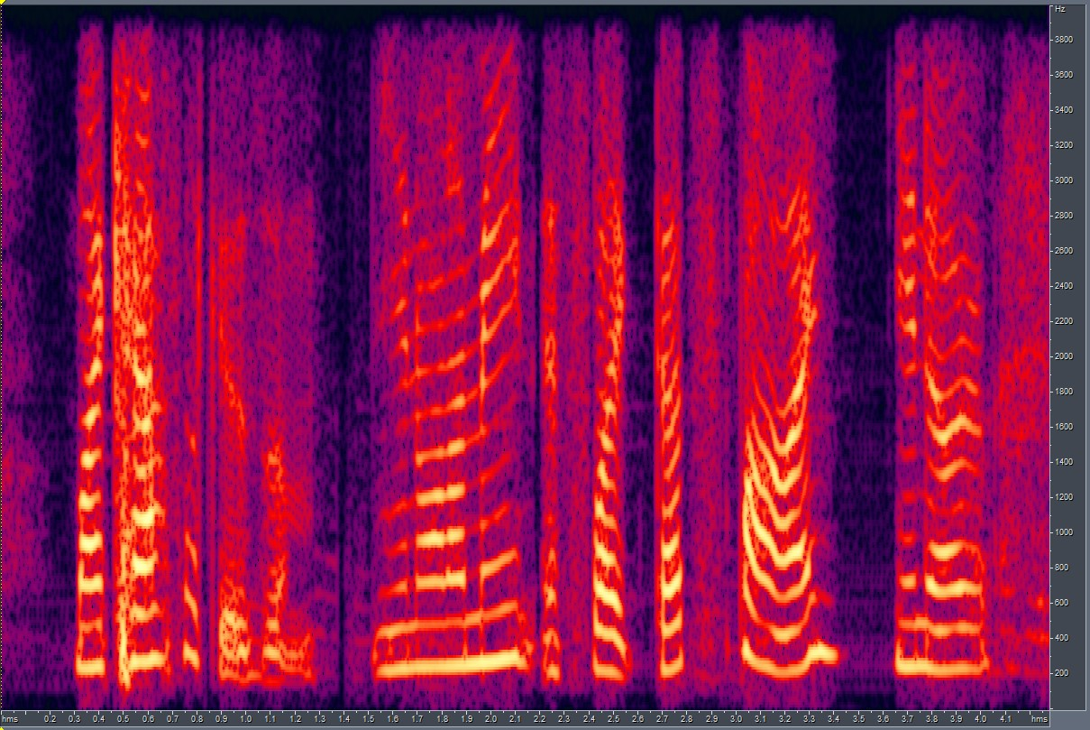
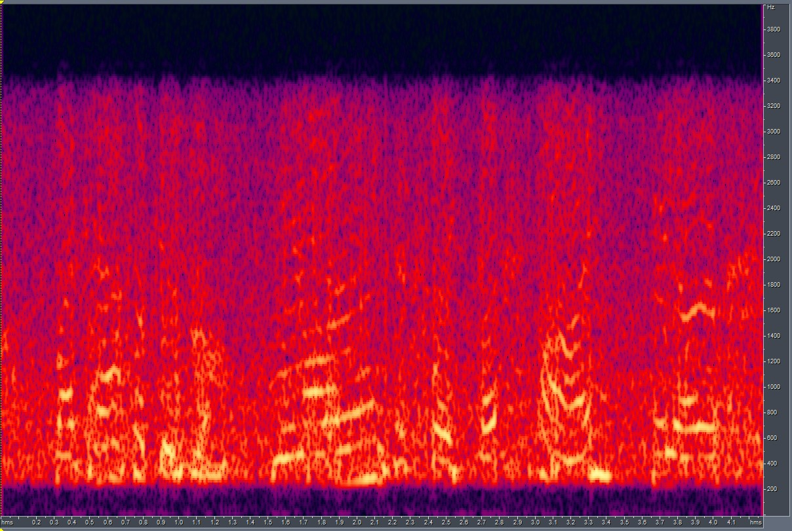
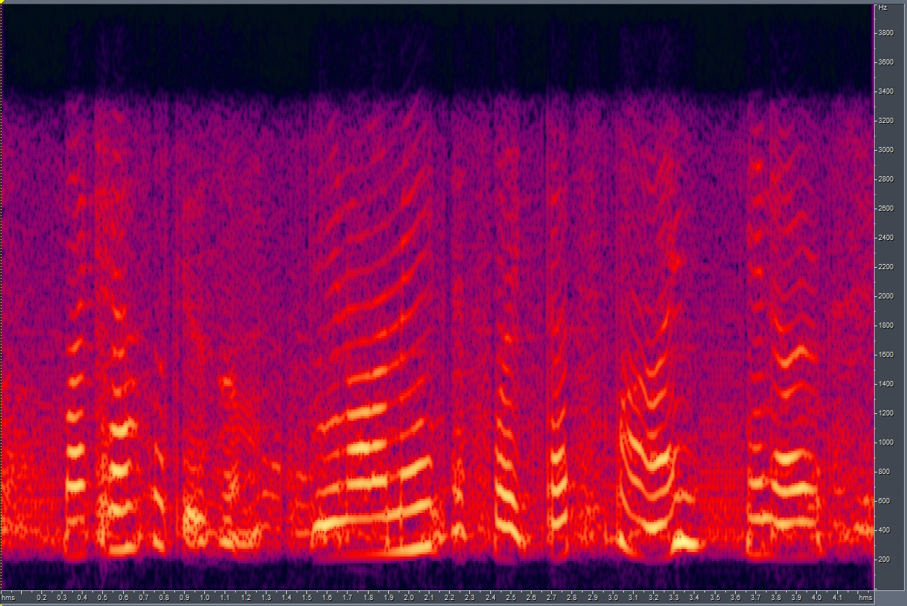
Results of CUT:
Clean Spectrogram
Target Noisy Spectrogram
Output Produced by CUT

Slide 8
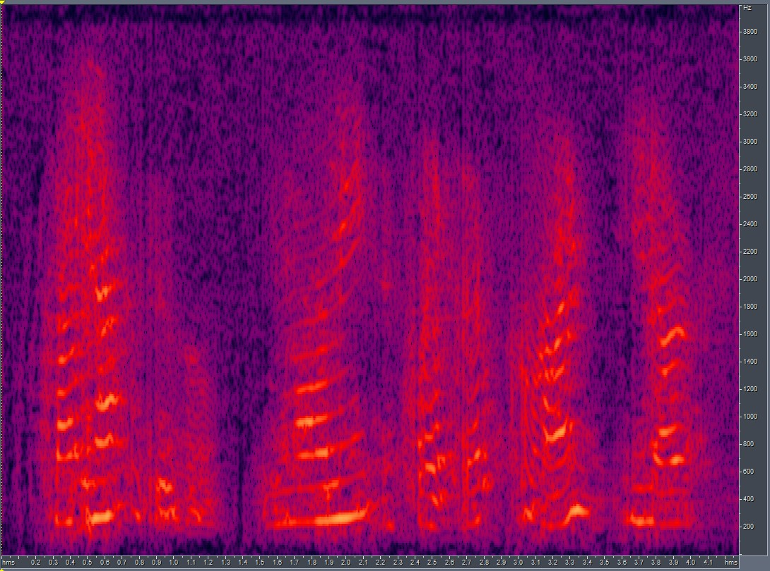
Quantitative Comparison of Output produced by CUT and SinGAN:
Log-Spectral Distance Scores:
LSD between Ground truth and:
Best output of SinGAN: 12.903
Output of CUT: 8.311
Mel-Cepstral Distortion Scores:
MCD between Ground truth and:
Best output of SinGAN: 17.509
Output of CUT: 9.094
CUT output
Ground Truth
SinGAN output

Slide 9
Further experimentation and tuning of CUT:
CUT works with 0-255 scale images. It has to be modified to work directly on Spectrograms of audio files.
It rescales the training images to a fixed size of 256x256. This block of code must be modified so that the dimensions of the input and output spectrograms remain identical.
We may try passing the input audio files through a codec first before training with CUT and determine if CUT learns to capture the noise characteristics.
Try the SinCUT module that works with a single image from each domain.

Slide 10
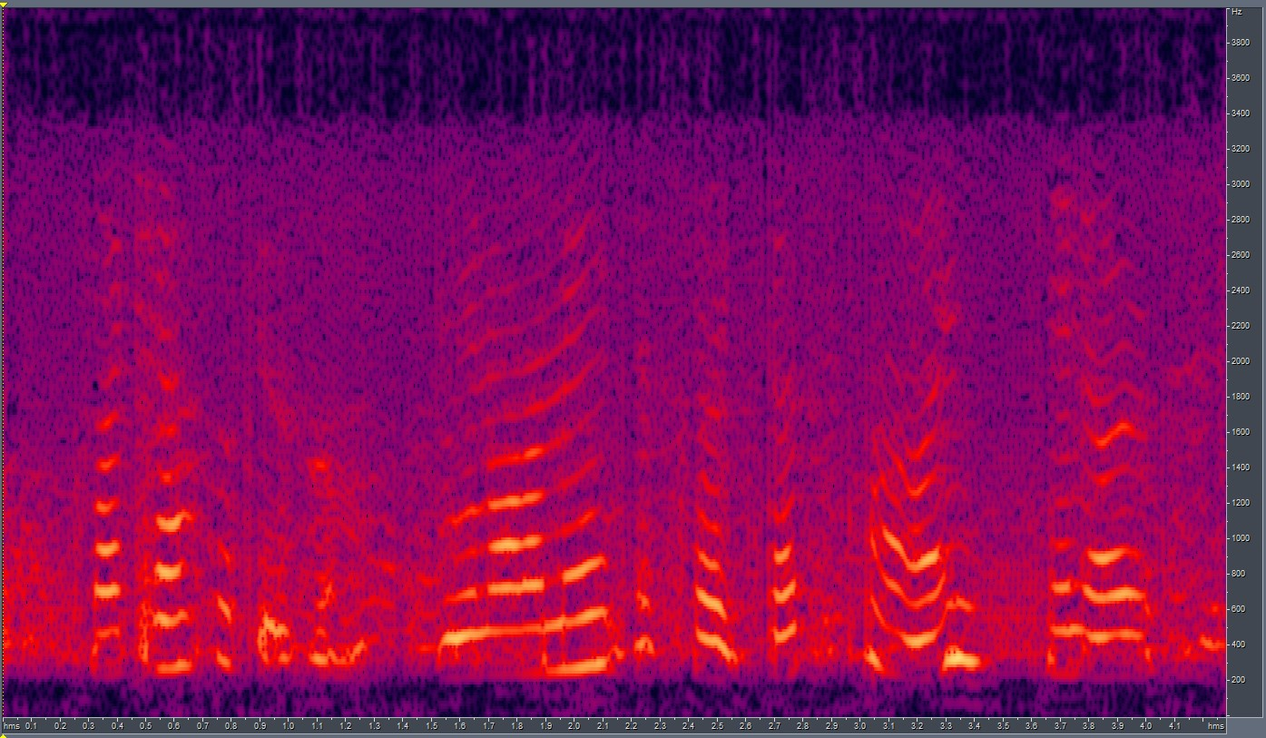
Using CUT + SinGAN:
Another approach we could explore is using CUT to train on the global structure + using SinGAN for learning the texture information.
Here, we use output of CUT with SinGAN for generation.
The results of using the two models in series are as follows:
LSD scores of the best output and Ground Truth:
LSD between scale_4 and GT = 8.784
As you can see, the output resembles the GT quite a bit. With upper frequencies correctly fading.
With a little fine-tuning, we could have a pipeline that produces good results.
We could also explore other texture transfer models that could better capture the noise.
CUT + SinGAN output
GT

Slide 11
End.

